Slide 1

Seasonally Adjusted Estimates of Caseloads of Children At Risk or with Severe Wasting

Slide 2
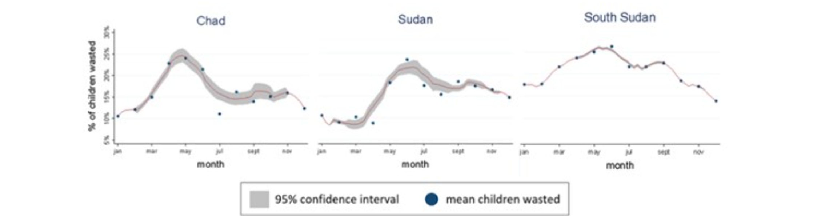
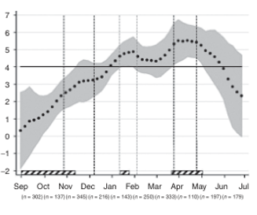
Ample evidence of seasonality of nutritional status
Twin Peaks Single Peak
Prevalence of wasting across months
(Chad, Sudan and South Sudan)
Seasonal variations in WHZ and wasting in Indian Surveys
Marshak A et al 2021 https://fic.tufts.edu/wp-content/uploads/Twin-peaks-study-report.pdf
Venkat, A et al (2021) Seasonality of acute malnutrition in African drylands: a review of 15 years of nutrition surveys
Seasonal variations in growth and body composition of 8–11-y-old Danish children
Marshak et al 2021 https://fic.tufts.edu/wp-content/uploads/Twin-peaks-study-report.pdf
Methods for assessing seasonal and annual trends in wasting in Indian surveys (NFHS-3, 4, RSOC & CNNS) Johnston et al 2020 https://journals.plos.org/plosone/article?id=10.1371/journal.pone.0260301
Stine-Mathilde Dalskov et al 2016
doi:10.1038/pr.2015.206
Point velocity versus all year linear average for body weight velocity (kg/y)

Slide 3
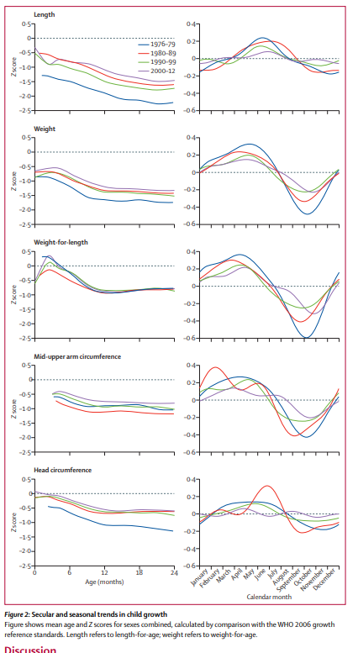

Seasonality of Wasting MRC Research Station The Gambia
Routine growth data from birth to age 2 years available for 3,659 children between 1976 and 2012 from three rural Gambian villages
Z scores for weight-for-age, length-for-age, weight-for-length, mid-upper-arm circumference, and head circumference were calculated using the WHO 2006 growth standards.
Seasonal patterns of mean Z scores were obtained by Fourier regression.
Notes:
https://www.thelancet.com/action/showPdf?pii=S2214-109X%2816%2930355-2

Slide 4
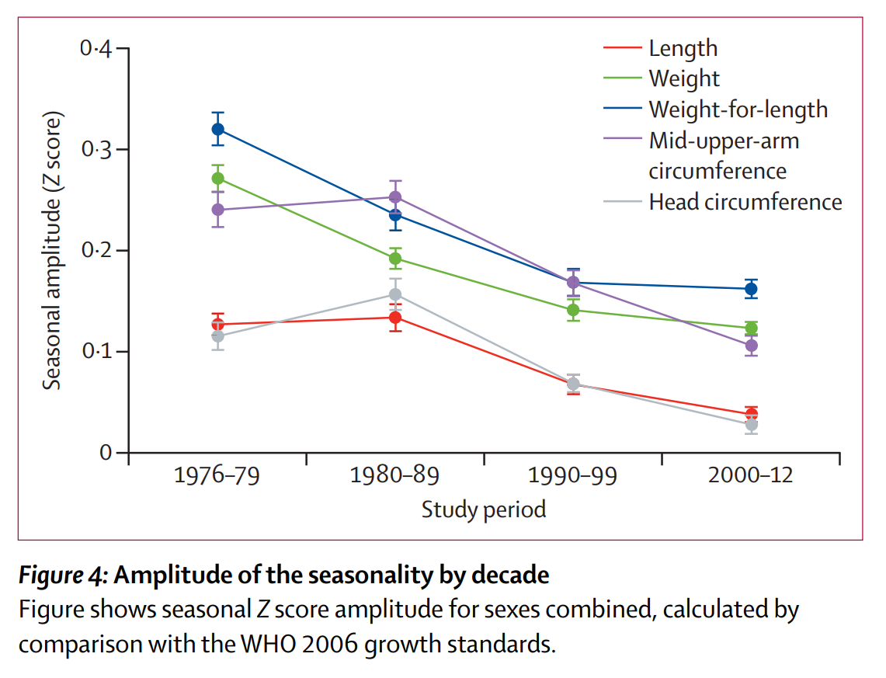
Seasonality of Wasting MRC Research Station The Gambia
Growth failure is markedly seasonal in this environment with greater deficits occurring in the rainy season (July to November) when infections are more common and maternal care declines due to the pressures of farming.
Figure 4 shows that there has been a substantial attenuation of the seasonality of growth during the four decades studied. When assessed as the amplitude of Z score fluctuation, this measure was significant for all indices in the order of a tenth of a Z score.
Notes:
https://www.thelancet.com/action/showPdf?pii=S2214-109X%2816%2930355-2

Slide 5
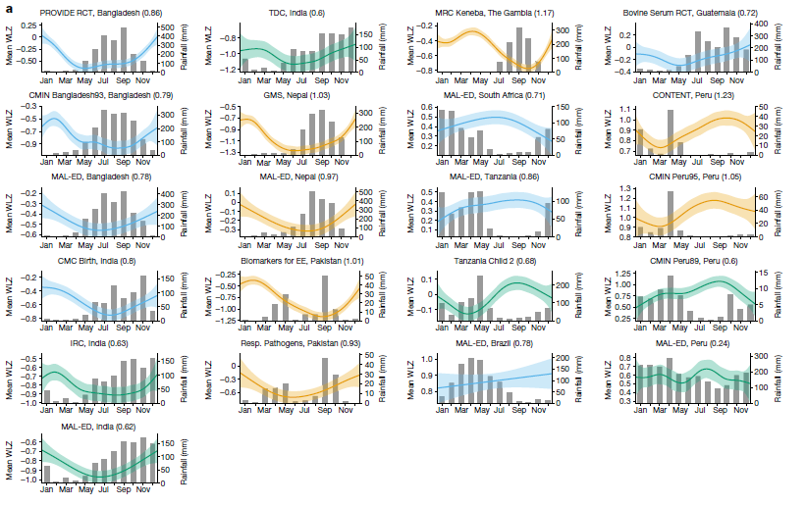
Seasonality of wasting in Longitudinal Data
Data from 21 longitudinal cohorts and show that wasting is a highly dynamic process of onset and recovery
Graphs present mean WLZ by day of the year, superimposed over histograms of monthly mean rainfall over study periods, with the cohort name and seasonality index of rainfall.
Studies from Brazil and most recent from Peru show little to no seasonal variation of WHZ scores
Mertens, A., Benjamin-Chung, J., Colford, J.M. et al. Child wasting and concurrent stunting in low- and middle-income countries. Nature 621, 558–567 (2023). https://doi.org/10.1038/s41586-023-06480-z -
Notes:
Mertens, A., Benjamin-Chung, J., Colford, J.M. et al. Child wasting and concurrent stunting in low- and middle-income countries. Nature 621, 558–567 (2023).
https://doi.org/10.1038/s41586-023-06480-z -
https://www.nature.com/articles/s41586-023-06480-z

Slide 6
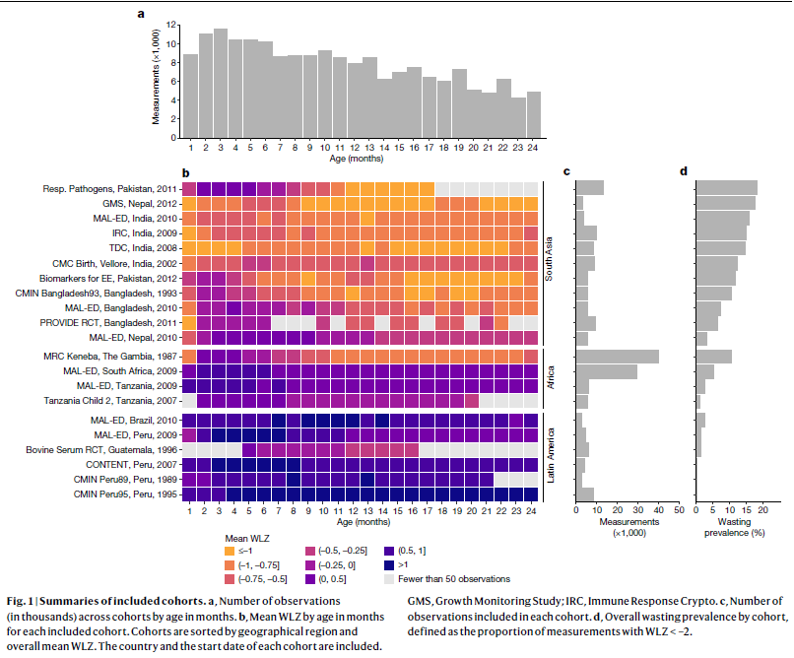
Seasonality in Longitudinal Data
21 longitudinal cohort datasets from three continents (Africa, South Asia and Latin America)
Data from children from 0-23 months of age
Data from countries with a range of wasting prevalence from 0 to 15%
Studies from 1989 -2012. Must be attentive of dates of surveys as seasonal variation is decreasing in stable countries and growing economies
Mertens, A., Benjamin-Chung, J., Colford, J.M. et al. Child wasting and concurrent stunting in low- and middle-income countries. Nature 621, 558–567 (2023). https://doi.org/10.1038/s41586-023-06480-z -
Notes:
Mertens, A., Benjamin-Chung, J., Colford, J.M. et al. Child wasting and concurrent stunting in low- and middle-income countries. Nature 621, 558–567 (2023).
https://doi.org/10.1038/s41586-023-06480-z -
https://www.nature.com/articles/s41586-023-06480-z

Slide 7
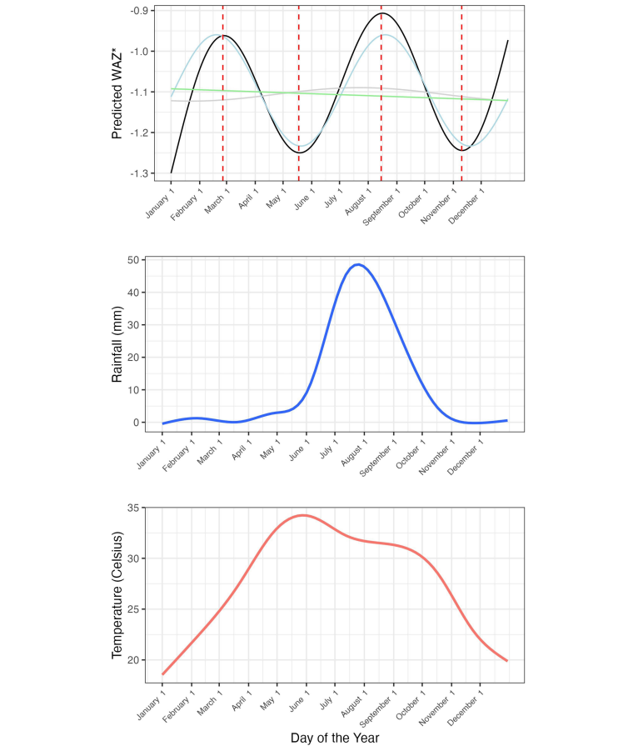
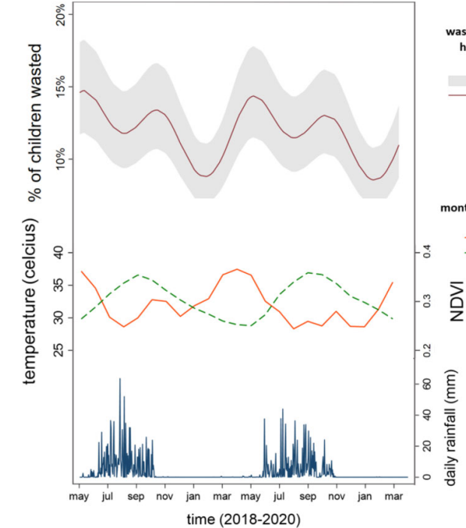
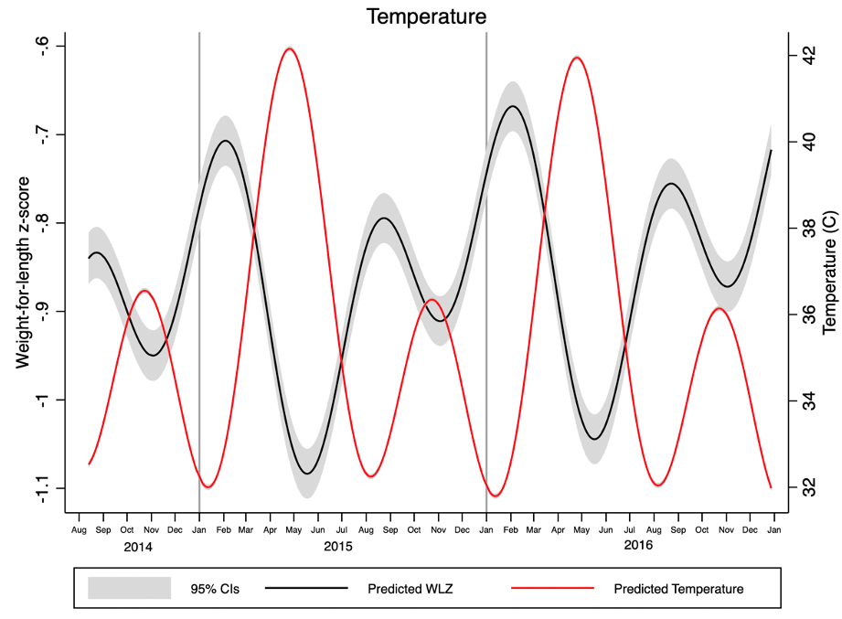
Seasonal malnutrition is associated to temperature
Niger
Chad
Burkina Faso
https://www.sciencedirect.com/science/article/pii/S0002916523661684
https://journals.sagepub.com/doi/pdf/10.1177/03795721231181715
https://gh.bmj.com/content/bmjgh/10/3/e017643.full.pdf

Slide 8
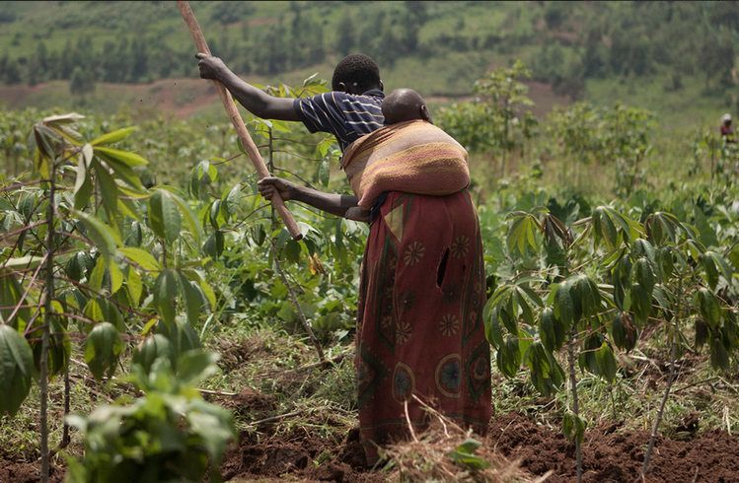
Why does wasting in children peak during the hottest months of the year?
Heat-Related Anorexia
High temperatures suppress appetite (especially in children).
Reduced food intake leads to energy deficits and weight loss.
Poor Water Quality and Quantity
Drought or water scarcity limits hygiene and safe drinking water.
Increased risk of waterborne illnesses
Increased Disease Burden
Diarrheal diseases, malaria, and respiratory infections increase.
Infection leads to nutrient loss, poor absorption and wasting.
Increased Labor Demands on Caregivers
Agricultural or income-generating work peaks during hot months.
Children may be left with alternate caregivers or unattended.
Reduced Breastfeeding and Child feeding
Heat stress and caregiver fatigue may reduce breastfeeding frequency.
Breastmilk intake may decrease due to illness and anorexia.
Caregivers may have less time for child feeding due to labor demands.
Food Insecurity
Hot season often coincides with pre-harvest (lean) season.
Household food stocks can reach lowest levels and dietary diversity at minimum.

Slide 9
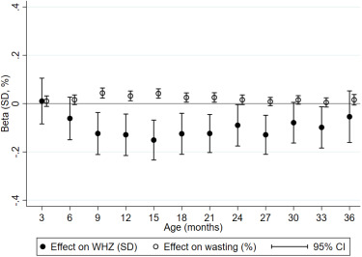
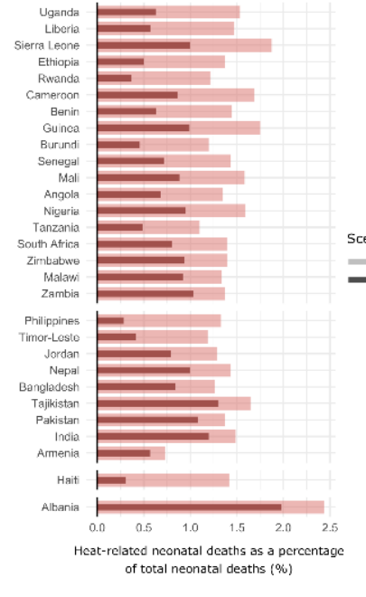
The effect of heat on mortality and nutrition
Child mortality and heat exposure
Child malnutrition and heat exposure
A study of DHS data from 29 low- and middle-income countries from 2001 to 2019, found across all countries, 1.5% of neonatal deaths were heat-related.
Age-specific effects of 100 h of mean monthly exposure to 30–35 °C in the last 90 days on WHZ and wasting
From 9–15 months, a 100 h of mean monthly exposure to 30–35 °C heat increases the risk of wasting by about 4 percentage points.
Similarly, 100 h of exposure above 35 °C increases the prevalence of stunting by 6 percentage points
https://www.nature.com/articles/s41467-024-49890-x?s=03#Sec12
https://www.sciencedirect.com/science/article/pii/S0095069622000626
Notes:
Add Heat and child mortality

Slide 10
The importance to use a seasonally adjusted estimate of wasting for annual planning
Seasonal peaks and troughs do not always correspond to common assumptions (especially when wasting presents twin peaks)
Use of data collected in February will underestimate the caseload.
Use of data collected in May will overestimate the caseload
FEB – severe wasting -1.0%
MAY – severe wasting 2.6%

Slide 11
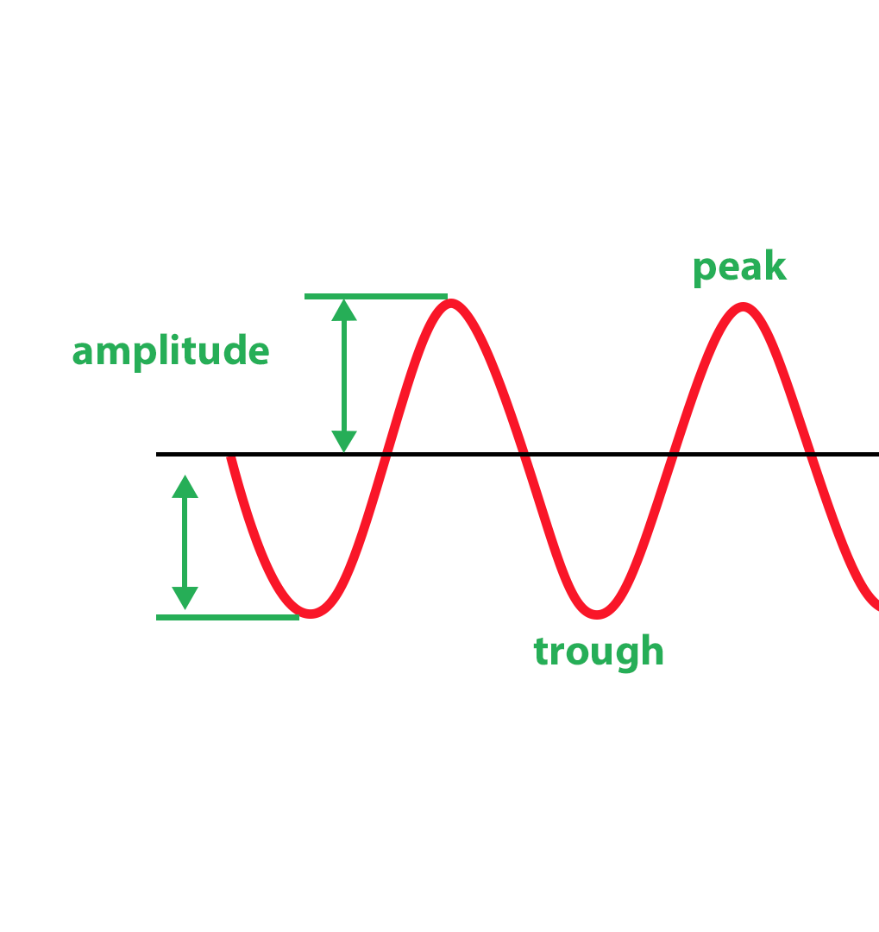
How to estimate the amplitude of annual severe wasting
The amplitude is the half width of the annual variation of severe wasting.
The amplitude can be calculated from the prevalence of severe wasting or the WHZ-score
See the amplitude tab on the calculator for more information on expected amplitude of wasting in countries and regions.
Determine the amplitude of annual severe wasting variation (for children 0-59M) that closest corresponds to the conditions of the representative area of the calculator

Slide 12
To calculate at a seasonally adjusted estimate of wasting informed by the temperature
Enter the data in the pink cells
Enter the start and end date of data collection of the data source
Enter the expected annual amplitude for severe wasting (half width of annual variation)
Enter the recorded average peak temperature for all months of the year. Use a population adjusted estimate of average peak temperature so that the temperature corresponds to populated areas.
Survey Dates
Start date of survey | Enter the start month and year of data collection (DD/MM/YY). If the day is not known, enter 15 as day. |  |  |  |  |  | 01/08/23
End date of survey | Enter the end month and year of data collection (DD/MM/YY). If the day is not known, enter 15 as day. |  |  |  |  |  | 30/10/23
Seasonality Model Inputs
Amplitude | Enter the amplitude of annual wasting variation (for children 0-59M) |  |  |  |  |  | 0.8
January temperature | Enter the average maximum |  |  |  |  |  | 32.8
February temperature |  | temperature in Celsius for the |  |  |  |  | 35.6
March temperature |  | representative area, month/year |  |  |  |  | 38.3
April temperature |  |  |  |  |  |  | 38.9
May temperature |  |  |  |  |  |  | 37.2
June temperature |  |  |  |  |  |  | 34.4
July temperature |  |  |  |  |  |  | 31.7
August temperature |  |  |  |  |  |  | 30.6
September temperature |  |  |  |  |  |  | 32.2
October temperature |  |  |  |  |  |  | 35.6
November temperature |  |  |  |  |  |  | 35.6
December temperature |  |  |  |  |  |  | 33.3
Notes:
Hypothesis

Slide 13
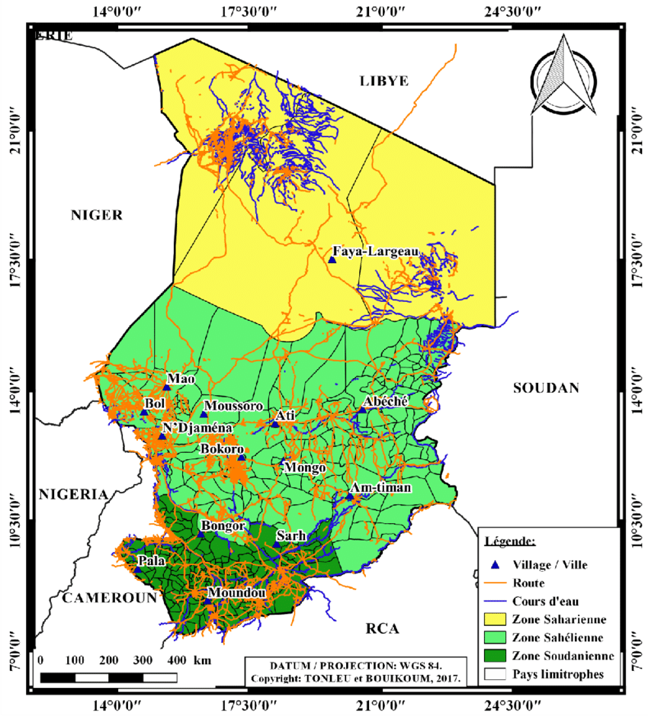
Validation process
All input data used in the calculator must be documented and validated by national experts.
If the annual caseload calculations for a country or a representative area are based on multiple data sources (nutrition surveys), a separate calculator must be used for each source.
Additionally, if an area represented in the annual caseload calculations is considered to exhibit no or a different pattern of seasonal variation (for example, in the zone Saharienne or Soudanienne), a separate calculator should be used for each different area.

Slide 14




Validation and Robustness testing
Validation of estimates and trends with:
Longitudinal wasting data where available
Management of severe wasting admissions
Malaria incidence and other child illness data where available
Contextual food security and Integrated Phase Classification data
Robustness testing by:
Validation of results from z-score versus prevalence derived from Z-scores
Assessment of results disaggregated by socio-economic status, mother’s education, region, urban/rural and others
Assessment of results over months and years recognized as nutrition emergencies
For countries with minimal data available, consider:
Use of neighboring country models for validation of national estimates

Slide 15
Notes:
Presentation Title:
Seasonal Caseload Estimates of At-Risk Children: 0–59 Months
1. Introduction
Objective of the Presentation
To present seasonal caseload estimates for children with SAM (6–59 months)
To highlight risk burden among infants 0–5 months
Why It Matters
Malnutrition remains a major cause of child mortality
Timely planning is essential for seasonal peaks
2. Background and Definitions
Severe Acute Malnutrition (SAM)
Definition and criteria (e.g., WHZ <-3, MUAC <115 mm, or nutritional edema)
Impact on child mortality and development
Children 0–5 Months at Risk of Poor Growth
Definition of “at-risk” (e.g., low weight-for-age, feeding issues, low MUAC)
Importance of early identification
3. Data Sources and Methodology
Survey Data
Sources (e.g., SMART surveys, DHS, MICS, HMIS)
Caseload Estimation Formula
Prevalence × Population × Coverage Correction × Incidence Correction Factor
Seasonal Analysis
Disaggregation by season (e.g., lean season, harvest season)
Geographic variation
4. Results – Children 6–59 Months (SAM)
Total Caseload Estimates by Season
Seasonal Trends
Peaks in lean seasons (e.g., pre-harvest)
Hotspot Areas
Sub-national breakdown (map/graphs)
Comparisons Across Years (if available)
5. Results – Children 0–5 Months at Risk
Caseload Estimates
Challenges in data availability
Associated Risk Factors
Low birth weight, feeding practices, maternal nutrition
Programmatic Gaps
6. Implications for Programming
Preparedness for Peak Periods
Stockpiling of therapeutic foods
Surge staffing and outreach
Integrated Interventions
CMAM programs for SAM
Early intervention for at-risk infants
Coordination Needs
Linking with maternal health, IYCF, ECD programs
7. Recommendations
Short-term
Pre-positioning supplies before peak seasons
Strengthen screening and referrals
Long-term
Improve data for 0–5 months group
Integrate risk monitoring into routine systems
8. Conclusion
Summary of Key Findings
Call to Action
Use seasonal trends for more responsive programming
Invest in early detection and prevention
9. Annex (Optional Slides)
Methodological assumptions
Full data tables
Maps or heat charts

